Slide 1
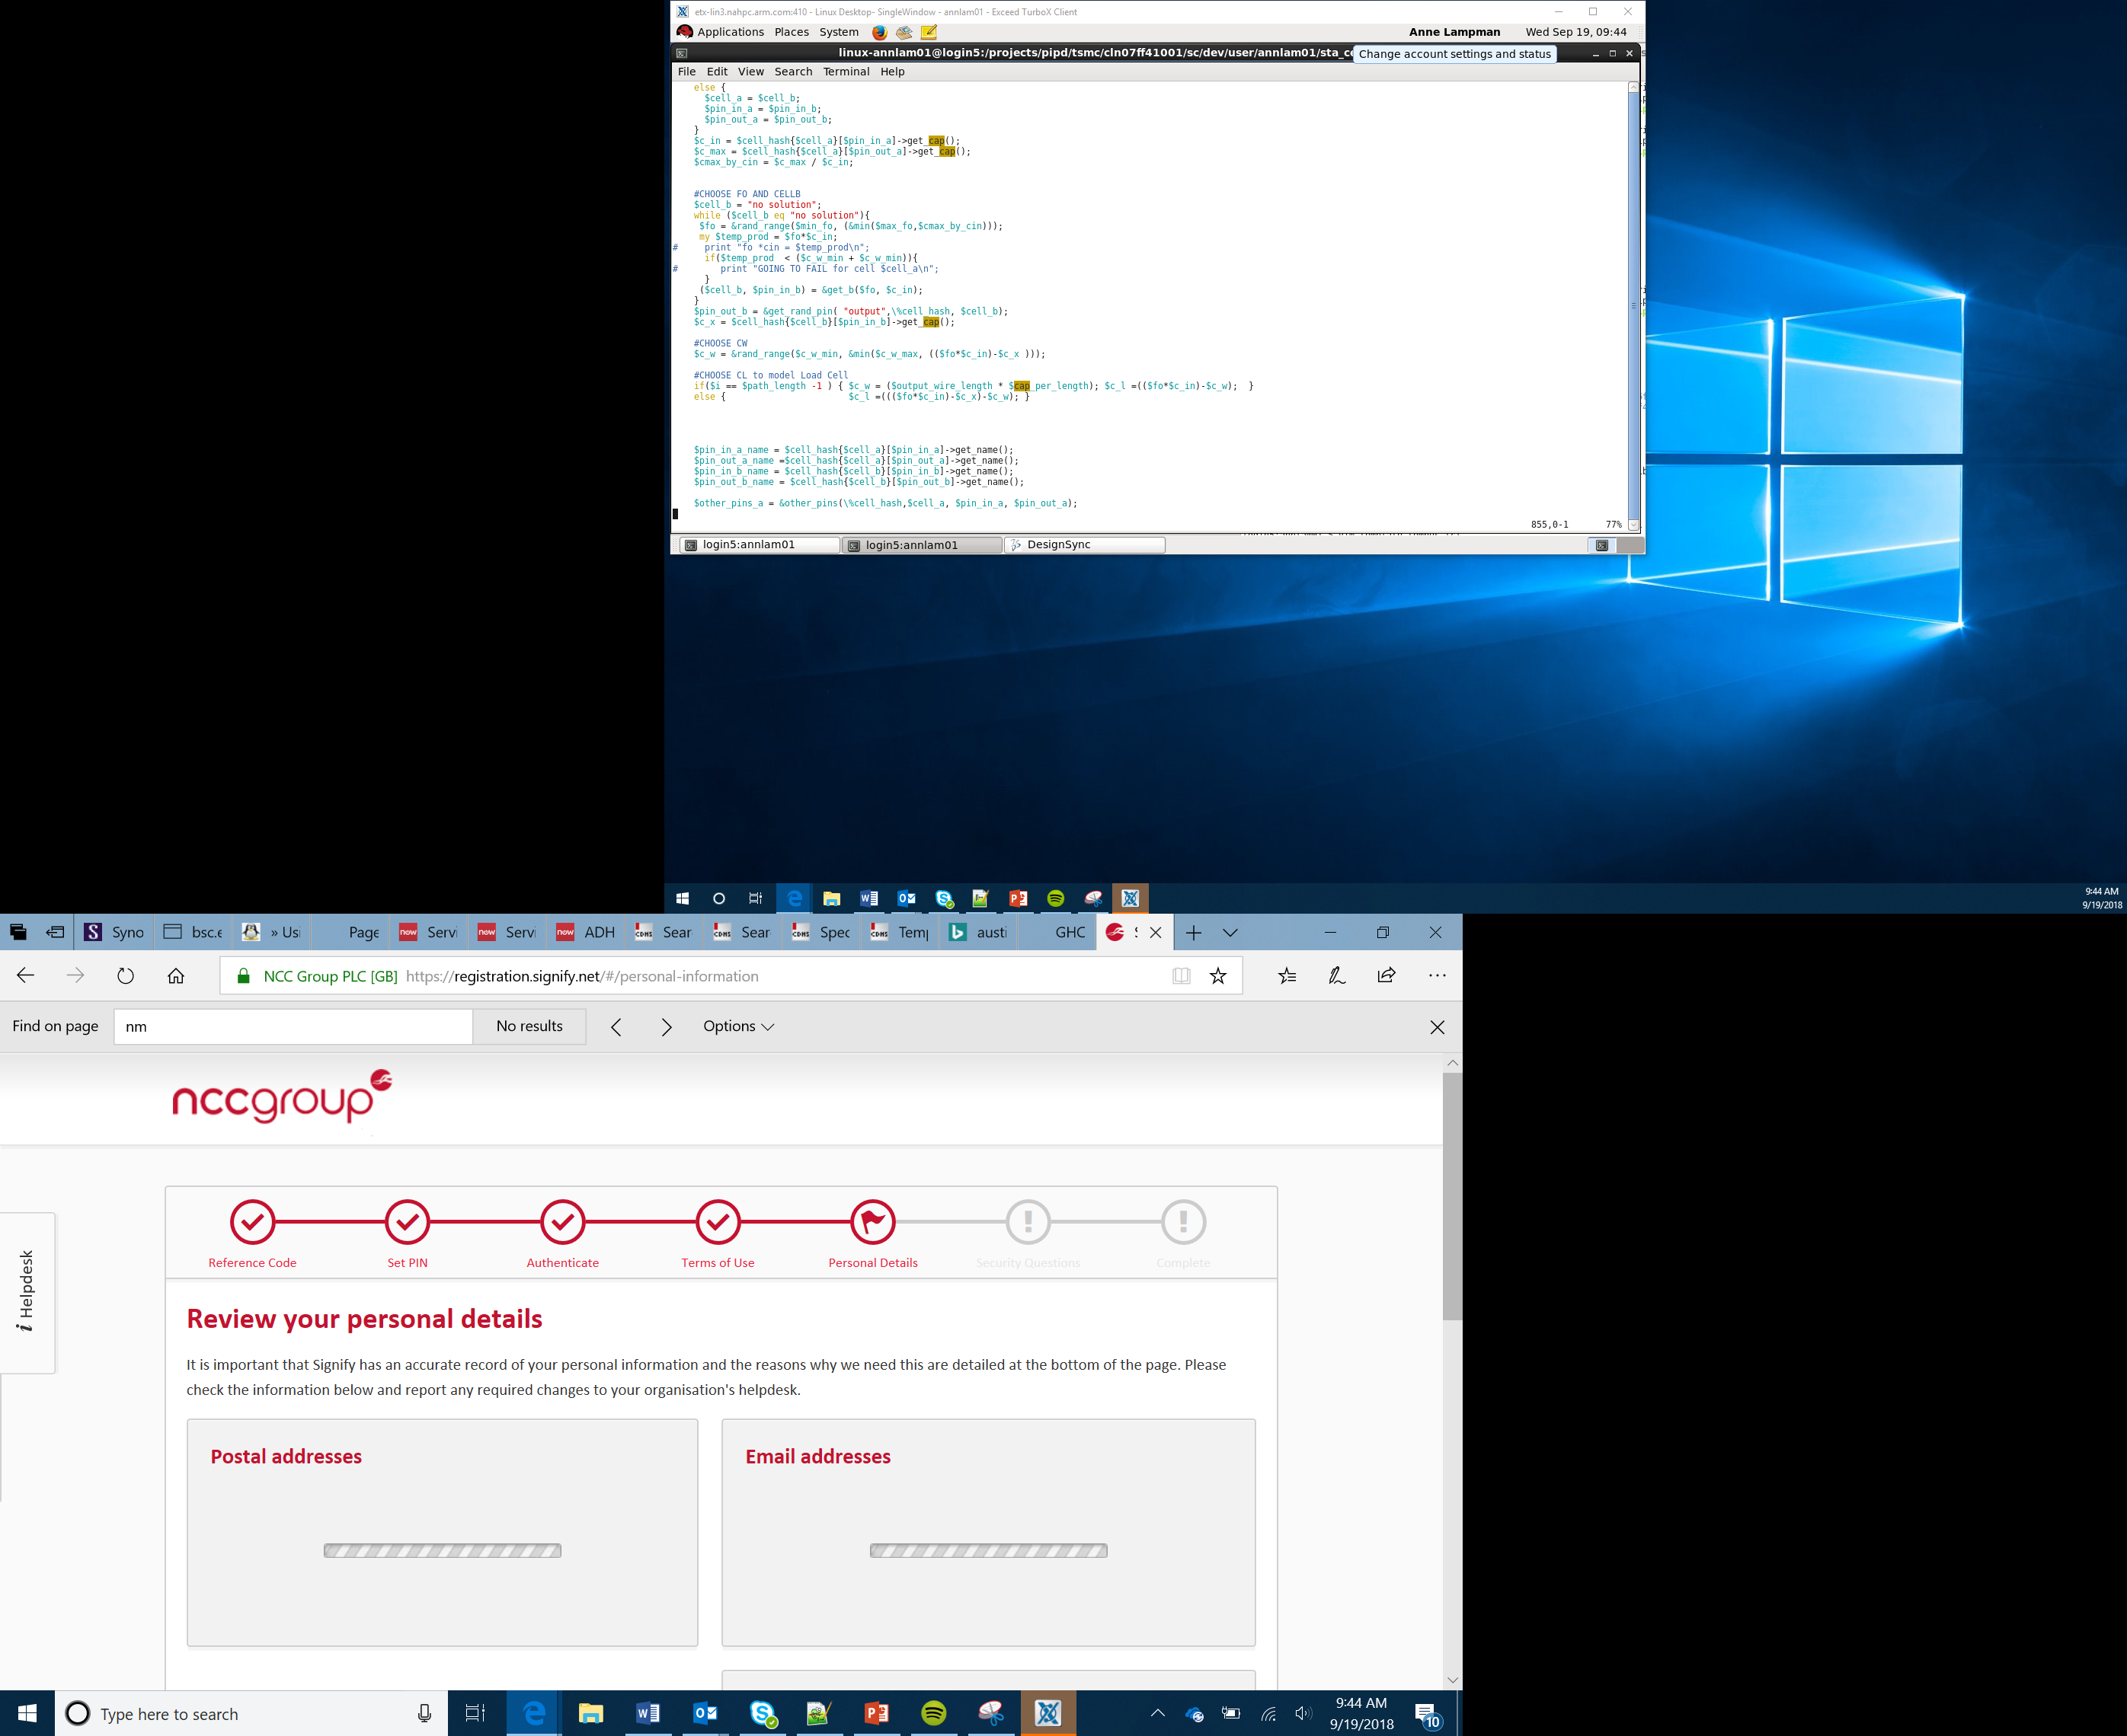

Lock box
Lesson 8

Slide 2
Success criteria
Understand how to use an actuator
Understand how to combine multiple peripherals to be controlled by one control board
Create a lock box which requires a 4-digit PIN to unlock

Slide 3
Arrays
An array allows you to store multiple values under one identifier
This project will use an array to store the entered values and a further array to store the correct values
The program will then see if the values in the two arrays match
If they do, it will light up a green LED and trigger the actuator (servo) to unlock the box

Slide 4
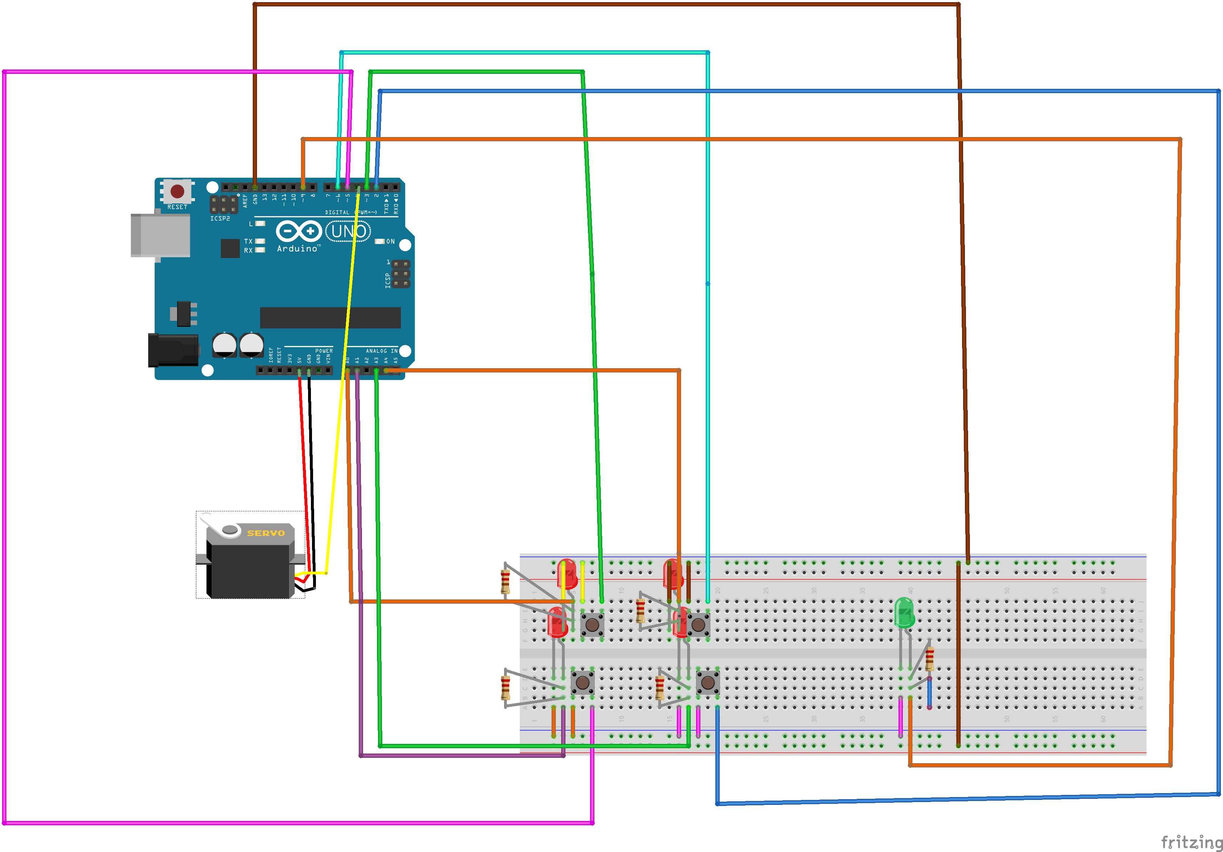
Building the circuit
You are now going to build the circuit
Be careful to ensure that the different elements are connected into the correct sockets

Slide 5
Planning your program
Using either a flowchart or pseudocode you should design your algorithm
When a button is pressed, it should light up the corresponding red LED
Once four values have been entered, it should check the values against the correct PIN
If the values are correct, the green LED will light up and trigger the actuator to unlock the box

Slide 6
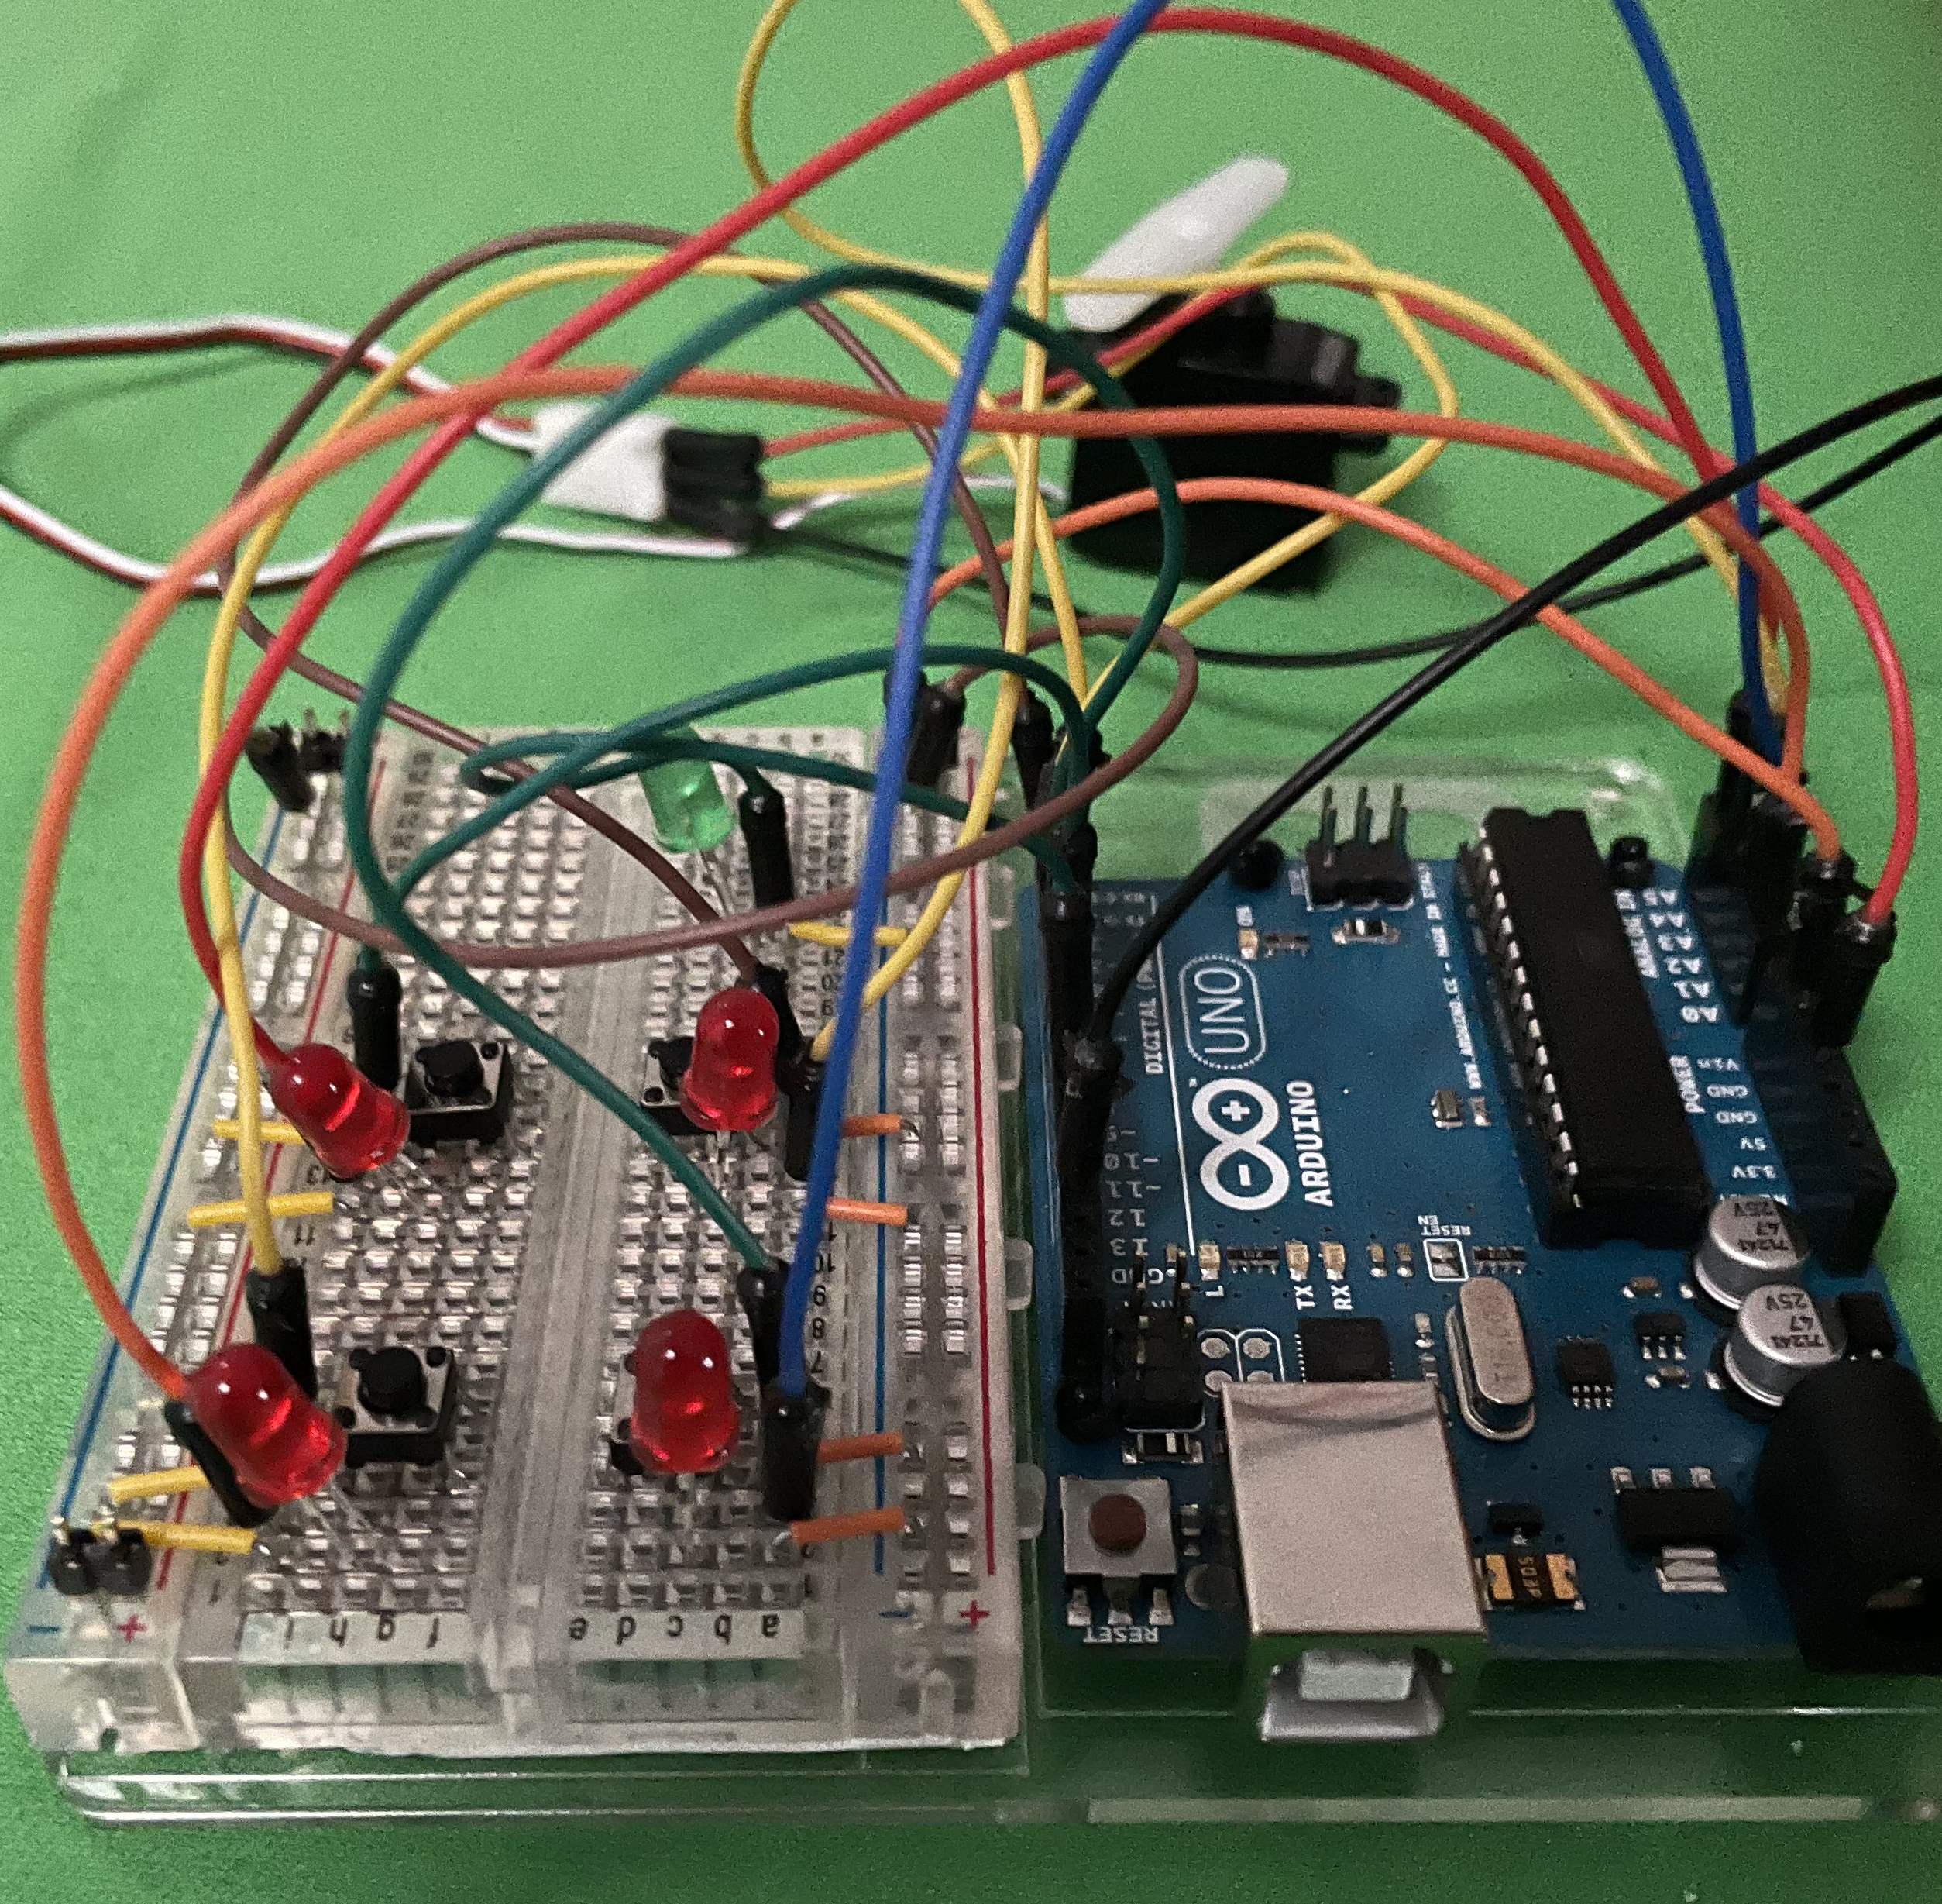
Developing your code
Work through the worksheet to write the code
Ensure that you understand the logic as this will be important when developing your own devices in the future

Slide 7
Summary
You can now use input devices to check a condition and then trigger an actuator
Using an array is an efficient method of storing multiple values under a single named identifier

